Slide 1

Auto-scaling as a service
Mandhani Kushal
Tapas Mallick
Pardhakeshwar Pacha
Suhas Naramballi

Slide 2
Outline
Introduction
Project Description
Deployment Topology
VM
Container
Implementation architecture
Demos
Future scope

Slide 3
Introduction
Service to leverage the resources of a remote VPC
Motivation:
Resources may be public cloud or other private cloud
Automated scaling
Objective is to use extra resources for a minimum amount of time and money
Notes:
2 more points

Slide 4
Project Description
Key aspects while making Scaling decisions:
When to scale (Scale up and scale down)
Where to scale
How much to scale
Other Considerations:
Cooldown options
Load Balancer Configuration options

Slide 5
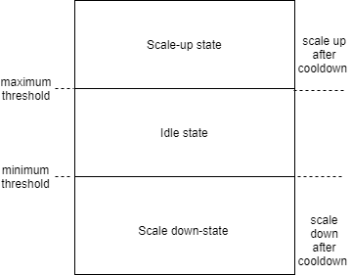
Functional features
Scale up: Determine when the load is in excess
VM: steal time of VM
Container: Avg. CPU usage of Container
Where to scale: choose a hypervisor with low load
VM: steal time of VM
Container: CPU usage of hypervisor.
How much to scale: 1 Unit VM/Container

Slide 6
Functional features-continued…
Scale down: Determine when the load has reduced
VM: steal time of VM
Container: Avg. CPU usage of Container
Cool-down period:
Scale up: wait reasonably before scaling up again.
Scale down: wait for user specified cool-down time before removing resources
Same behaviors for VMs and containers.
Notes:
Scope for discussing spawn time of VM and containers .

Slide 7
Management Feature
Configurability:
Flexibility for tenant to design the network.
CLI interface for tenant to input threshold and cool down.
Dynamic Monitoring
API provides tenant system snapshot.
Tenant: can monitor the load and events on the system.
Provider: can monitor the additional resources taken up by the customer.
Need to build trust between Tenant and Provider.
Smart-contracts need to be created.
Open-source blockchain technologies can be used to achieve this. Ex: Hyperledger.
Provides accountability for tenant and provider.

Slide 8
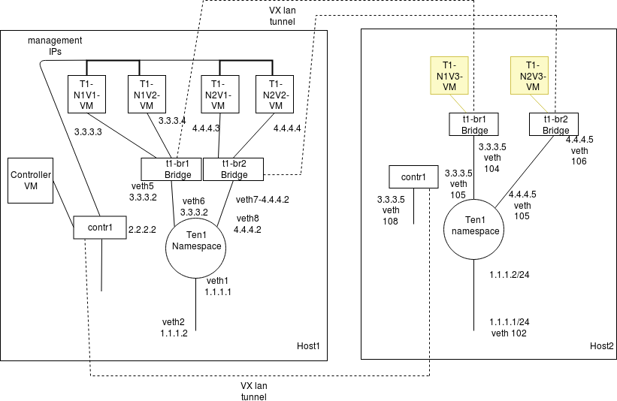
Deployment Topology - VM model

Slide 9
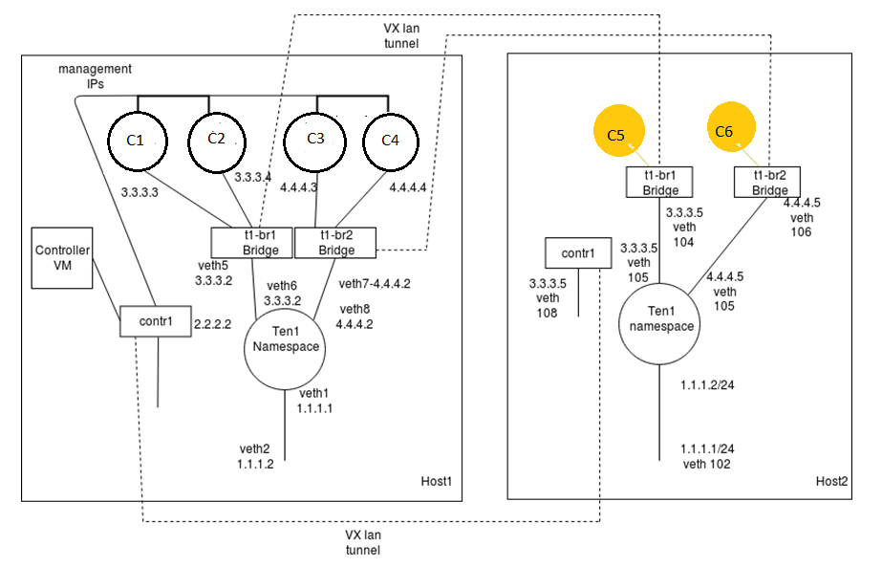
Deployment Topology - Container model

Slide 10
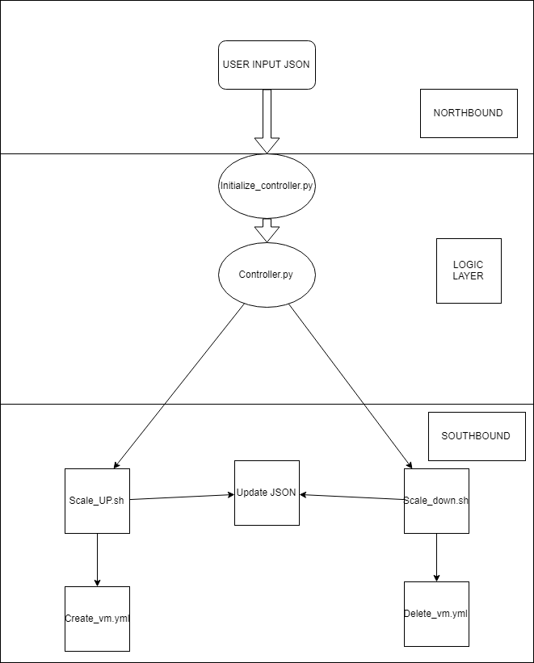
Implementation Architecture
NorthBound
Input JSON
CLI Interface
Core Logic Layer
Controller
Initial setup
SouthBound
Scale up and scale down
Update JSON

Slide 11
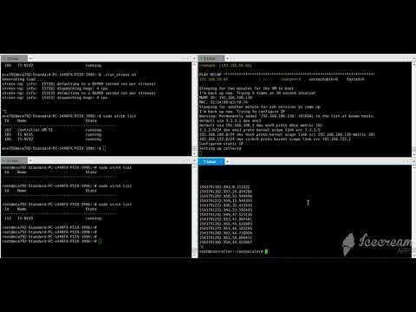

Slide 12
Demo 2

Slide 13
Future scope
Provide autoscaling for other parameters. Provide options to choose from Performance metrics like steal time or average cpu.
Provide accountability for tenant and provider using open source block chain tools such as hyper ledger
Changes to integrate with different public cloud vendors using their APIs. Ex: Spawn new resources in AWS/GCP while scaling up.
Self healing: Use the performance metrics to identify and fix failed resources.

Slide 14
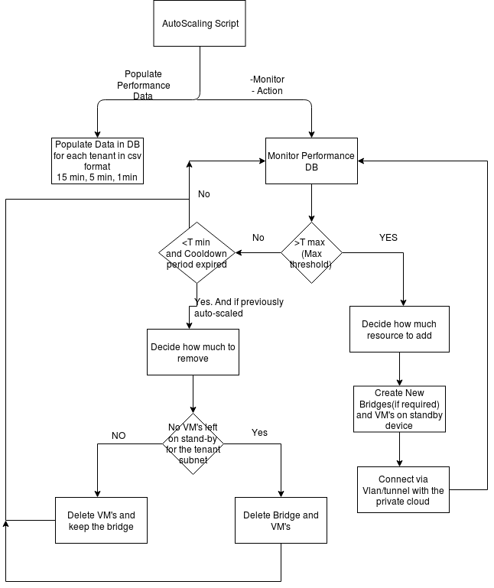
Appendix
Flow chart of the core logic

Slide 15
Thank You
Q&A

